Slide 1
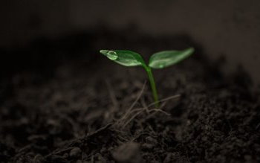
Leaf Diseases Prediction using Machine Learning​
By
Chinmay Kulkarni (19151265)
Pratiksha Thorat (19151167)
Hritik Kale (19151205)

Slide 2
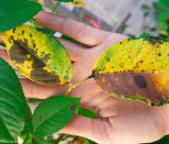
INTRODUCTION
In India 70% of population depend on agriculture and contributes 17% towards the GDP of country.
Farmers experience great difficulties in switching from one disease control policy to another. The naked eye observation of experts is the traditional approach, this method can be time consuming, expensive and inaccurate.
Currently, more and more attention has been paid to plant diseases detection in monitoring the large acres of crops.
Monitoring the health of the plants and detecting diseases is crucial for sustainable agriculture.
Plant diseases are challenging to monitor manually as it requires a great deal of work, expertise on plant diseases, and excessive processing time. Hence, this can be achieved by utilizing image processing techniques for plant disease detection.
The crop losses can be minimized by applying pesticides or its equivalent to combat the effect of specific pathogens, if diseases are correctly diagnosed and identified early.
Diseases found in agricultural crops is a major threat that cause production and economic losses as well as reduction in both quality and quantity of agricultural products.

Slide 3

OBJECTIVES
Forecasting of plant leaf disease (Quantification) as soon it appears on plant leaves
Automatic detection of plant leaf disease detection and classification.
Increase accuracies Using large dataset to train the Algorithm and maximize epoch values.
Make use of existing deep learning models for plant leaf disease detection and will check their performance on the basis of various evaluation.

Slide 4
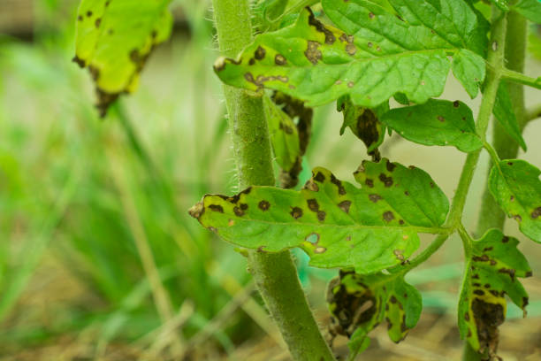
Existing system for Identification
The Trained model was deployed on a Computer Machine with Higher Hardware requirements.
User have to feed the image into the Model by using the Python File and the important thing in this model is, user must have installed the dependencies like Tensorflow, etc., in their system.
By using this, User can predict the disease of the plant. It doesn't provide the details and remedy measures of the disease of the plant being detected.
Training of ANN was performed using a Python library called Keras with Tensorflow backend , which is a deep learning framework.

Slide 5
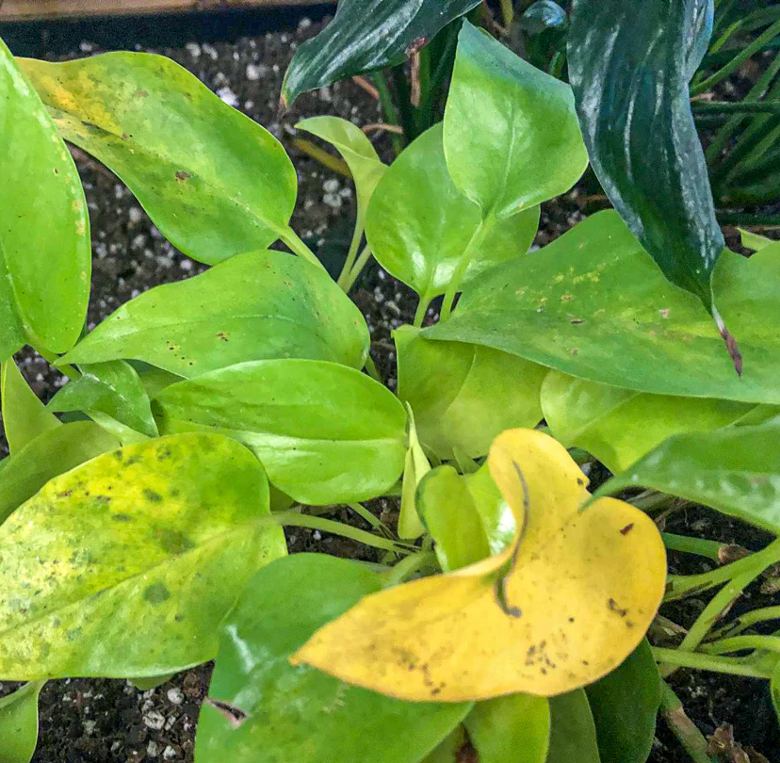
Proposed System
Training Phase
The proposed methodology includes detection of plant leaf diseases at early stage
In the proposed system, the image of leaves are captured and compared with images in the database of the leaves that are pre-stored in the device memory. If the leaf disease is detected then it intimates the user regarding diseases and it's required medication and cause.
Training Phase Machine Learning model is trained and tested in Anaconda environment and converted into TensorFlow lite model .

Slide 6
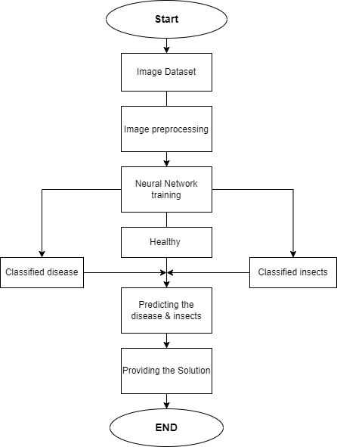
Identification process of crop diseases and insect pests based on CNN

Slide 7
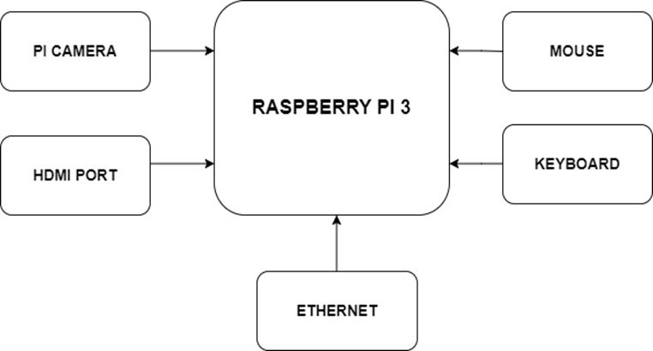
BLOCK DIAGRAM

Slide 8
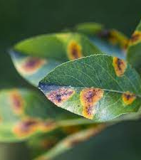
Steps For Classification
Modules
Importing the Libraries Loading the data
Label mapping
Transfer Learning with TensorFlow hub
Data Preprocessing
Build the model
Training Model
Checking Performance
Random test
Convert the model to TensorFlow Lite
Create a classifier class to load our model and read the file with labels

Slide 9
Paper 1
AUTHORS | PUBLICATION YEAR | PROPOSED WORK | OUTCOMES
Nithiswara Reddy Karthik Vinod Remya Ajai A | 2019 | 1 Proposed image pre-processing, image segmentation, image cleaning and machine learning model to detect plant diseases. 2 Enhancement and resizing makes the picture more contrast highlighting spots on leaves. Author implemented three image segmentation techniques like HSI, Otsu’s classification and K-Means clustering | Among K-Means and SVM, SVM performs well on data, accuracy is about 94-96% and K-Means accuracy is about 83-85%.

Slide 10
Paper 2
AUTHORS | PUBLICATION YEAR | PROPOSED WORK | OUTCOMES
Adil Khan Muhammad Saleem Mahar | 2020 | The model was trained and tested on Plant Village dataset (70295) images, by using 80% (56236) images of data to train and 20% (14059) images to test. The model is designed using 5-Covolution layers, 5-MaxPooling layers and trained on Plant Village dataset. | The model performed with an accuracy of 98%+ testing accuracy on plant village dataset and 95%+ testing accuracy on actual environment image.

Slide 11
Paper 3
AUTHORS | PUBLICATION YEAR | PROPOSED WORK | OUTCOMES
Nikhil Shah Sarika Jain | 2019 | Image enhancement and image segmentation extracts important features of the defected leaf like spot, blight or mould. RGB and HSV image are used for training ANN after preprocessing image, model will accept the leaf without disease and reject the leaf with disease. | MSE is 6.105e10 for 953 epochs. There is a huge difference between predicted one and target one.

Slide 12
Paper 4
AUTHORS | PUBLICATION YEAR | PROPOSED WORK | OUTCOMES
Rishabh Sachana Diksha Rajpal | 2020 | The model was trained on 3340 corn leaf images, tested on 363 images, and validated on 679 images. The model accuracy on GPU is 96.32% | The overall 98.40% accurate while on real time system (NCS) the performance is 88.66% accurate

Slide 13
Paper 5
AUTHORS | PUBLICATION YEAR | PROPOSED WORK | OUTCOMES
J.Selvam P. Kavitha | 2020 | This CNN model consists of four convolutional appended by max pooling with kernel size 2 X 2 and followed by two fully connected layers with 500 and 3 neurons. Convolutional layers are processed by ReLu function and output layer is triggered by Softmax function. | 50 epochs without dropout layer gave an accuracy of 96 percent. Small Number of Examples in the dataset.

Slide 14
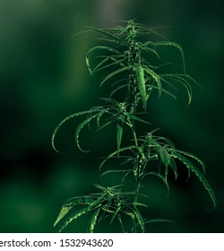
ADVANTAGES
The main advantage of automatic plant disease detection is to protect crop production from quantitative losses.
Automatic detection of plant disease is essential as it may prove beneficial in monitoring large fields of crops and thus automatically detect the symptoms of diseases as soon as they appear on plant leaves.
This system can work as a universal detector, recognizing general abnormalities on the leaves such as scorching or mold, etc.
It can be implemented to increase crop productivity by ensuring the quality and quantity of the food product.

Slide 15
CONCLUSION
The use of automated monitoring and management systems is gaining increasing demand with technological advancement.
In the agricultural field loss of yield mainly occurs due to widespread disease.
Mostly the detection and identification of the disease are noticed when the disease advances to a severe stage, therefore, causing a loss in terms of yield, time, and money.
The proposed system is capable of detecting the disease at the earlier stage as soon as it occurs on the leaf, Hence saving the loss and reducing the dependency on the expert to a certain extent is possible.
It can provide help for a person having less knowledge about the disease, Depending on these goals, we have to extract the features corresponding to the disease.

Slide 16
References
Ashqar, B. A., & AbuNaser S.S. (2018).Image-based tomato leaves diseases detection using deep learning.
[2].Amara, J., Bouaziz, B., & Algergawy, A. (2017). A deep learning-based approach for banana leaf diseases classification. Datenbanksysteme für Business, Technologie und Web (BTW 2017)-Workshopband.
[3].Ramcharan, A., Baranowski, K., McCloskey, P., Ahmed, B., Legg, J., & Hughes, D. P. (2017). Deep learning for image-based cassava disease detection. Frontiers in plant science, 8, 1852.
[4].Ferentinos, K. P. (2018). Deep learning models for plant disease detection and diagnosis. Computers and Electronics in Agriculture, 145, 311-318.
[5].Ghaiwat, S. N., & Arora, P. (2014). Detection and classification of plant leaf diseases using image processing techniques: a review. International Journal of Recent Advances in Engineering & Technology, 2(3), 1-7.

